Slide 1
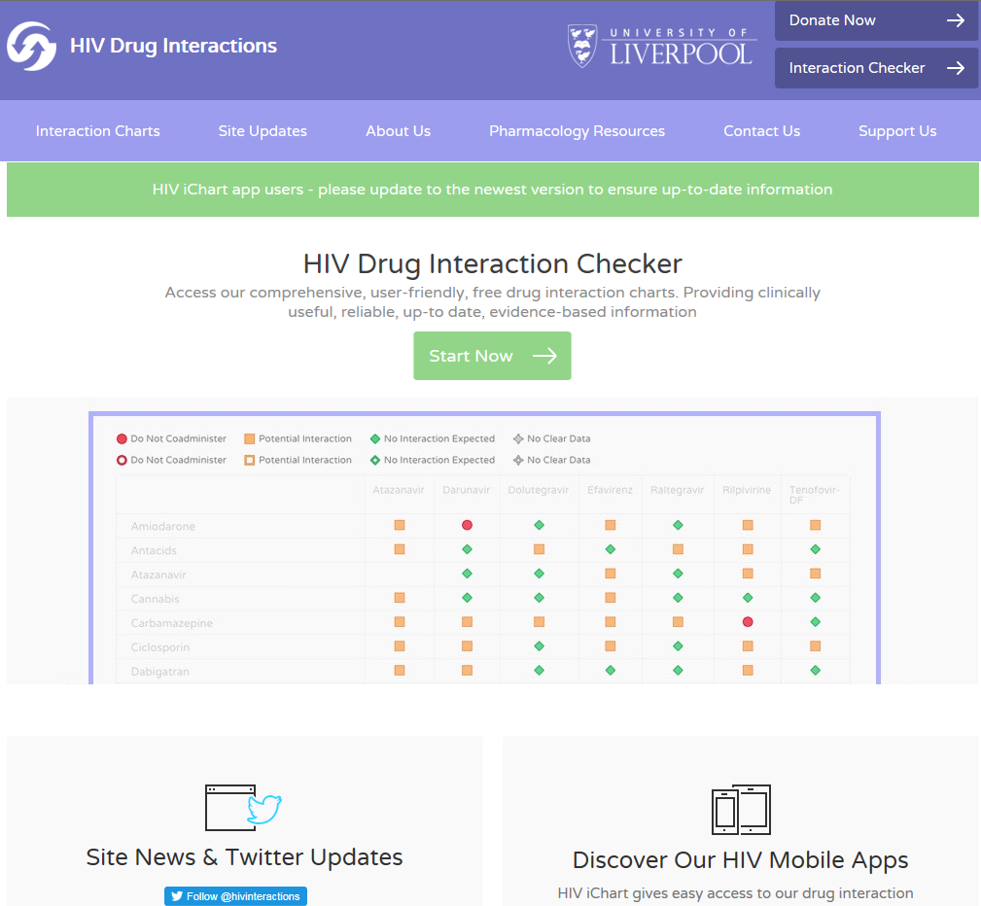
Basic principles of DDIs with ARVs: an introduction
David Back
University of Liverpool

Slide 2
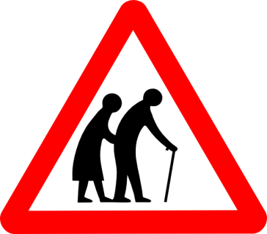
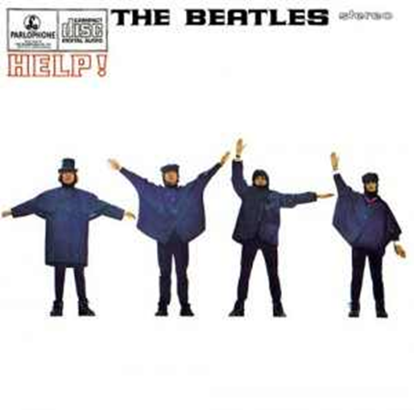
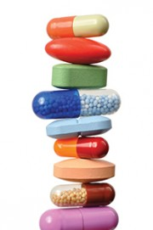
1. The Problem
Increasing numbers of patients on ARVs
Relatively few formal DDI studies
Ageing Population
DDIs:
Are not going away!
Different prescribers
Polypharmacy
Increased use of
‘Over the Counter’
Online access to drugs
Recreational drugs
Adapted from Okoli C - with permission

Slide 3
2. The Pharmacology
Does the ARV drug alter the exposure (concentration) of other drugs?
Do other drugs alter the exposure of the ARV drug?
If Yes – what is the magnitude of the change in PK parameters?
If Yes – what is the clinical significance of the DDI?
What is the appropriate management strategy for the DDI?
AEs
AEs
Perpetrator
Drug Concentration
ARV
Co-
med
Victim
Loss of
efficacy
Loss of
efficacy

Slide 4
3. The Potential of ARVs to Interact
Highest potential | Moderate Potential | Lowest Potential
Boosted PIs Perpetrators – enzyme and transporter Inhibition Victims - absorption (ATV); induction | Rilpivirine Victim of enzyme inhibition and induction. Also absorption. | Raltegravir Victim of absorption and a few induction interactions
EVG/cobi Perpetrator – enzyme and transporter inhibition Victim - absorption; induction |  | Dolutegravir Victim of absorption and a few induction interactions. Perpetrator of renal interaction
 |  | Bictegravir Victim of absorption and some induction/inhibition interactions. Also consider TAF
Efavirenz Perpetrator – enzyme and transporter induction |  | NRTIs Victim of some transporter mediated interactions. TDF & TAF > ABC, 3TC, FTC
Based on www.hiv-druginteractions.org

Slide 5
Selected Interactions for Boosted Regimens (PI/r; PI/c; EVG/c)
Drug class | Comment
Corticosteroids | Risk of Cushing syndrome.. Risk not just oral but inhaled, eye drops, injection, topical. Triamcinolone, budesonide, fluticasone, mometasone contra-indicated.
Antidepressants | Avoid tricyclics - can cause anticholinergic effects, sedation
Benzodiazepines | Caution. AEs increased . Use lowest dose for short duration. Midazolam, triazolam contraindicated.
Chemotherapy drugs | Increased risk of chemo related toxicities.
Anticoagulants; Vit K antagonists | Monitor INR. Dose adjustment may be required if switching from ritonavir to cobicistat.
Direct acting anticoagulant (DOAC) | Significant effect expected (limited data). Recommended - avoid with boosted regimens
Calcium channel blockers | Potential hypotensive effect. Start with lowest dose and titrate.
Statins | Some statins increased. Simva-, lovastatin contraindicated. Pitavastatin can be used. Others – start with low dose and titrate.
Think about long term use of boosters – particularly in older patients
Smith JM et al. AIDS 2017, Burgess MJ et al. HIV AIDS 2015; Nachega JB et al. AIDS 2012, www.hiv-druginteractions.org

Slide 6
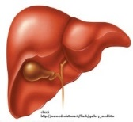
Selected DDI for Integrase Inhibitors
(RAL; DTG; EVG/c; BIC)
Drug Class | Comment
Cations: ie Antacids*, Calcium Iron | Integrase inhibitors bind to divalent cations in the g.i.tract which limits absorption. Variable decrease in exposure with potential risk of treatment failure.
Rifampicin | Rifampicin variably decreases DTG, EVG, BIC, RAL exposure.
Rifabutin | Rifabutin decreases EVG and BIC exposure but no clinically significant effect on DTG or RAL
Metformin | DTG, EVG/c, BIC variably increase metformin exposure (inhibits OCT2/MATE-1 in kidney). RAL has no effect. . Note: No DDIs with most other antidiabetic drugs.
*NOT omeprazole or other Proton pump inhibitors or H2 blockers
Smith JM et al. AIDS 2017, Burgess MJ et al. HIV AIDS 2015; Nachega JB et al. AIDS 2012, www.hiv-druginteractions.org

Slide 7
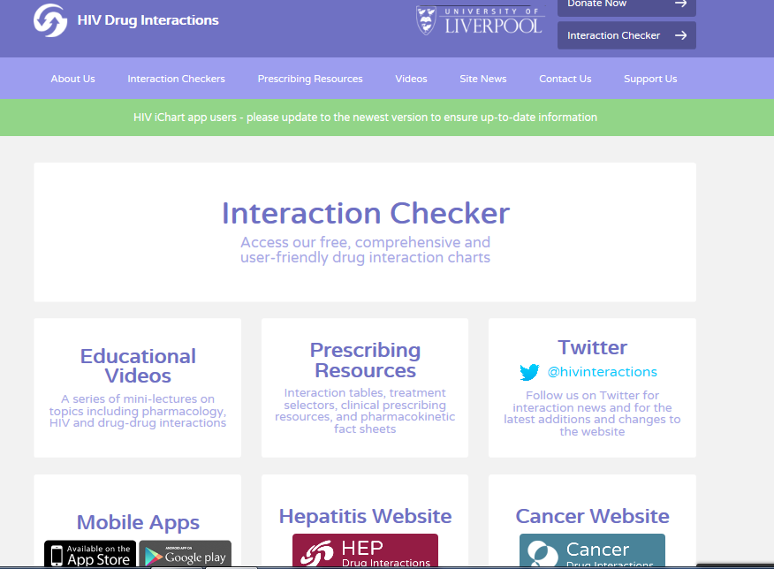
4. The Prescribers: help is at hand!
www.hiv-druginteractions.org

Slide 8
Key ARVs by Interaction Classification (Green, Amber/Yellow, Red) in Liverpool Database
Green: No interaction; Amber: Caution; Red: Contraindicated/not recommended
Some differences between RTV & COBI
Differences between the Integrase Inhibitors
Note: Data from ~700 co-meds (excluding ARV-ARV interactions) in www.hiv-druginteractions.org

Slide 9
MixPanel: Top Global Co-Med Searches for ART 2017

Slide 10
Interactions of Top Co-Med Searches for 4 key Antiretrovirals
/r

Slide 11
5. Some Perspectives
Changing Guidelines
Integrase-based; non boosting
2 Drug Regimens
Challenge of Long Acting
Integration of DDI information into EHR
Role of PBPK Modelling

